Slide 1
An Analysis of Machine Learning Techniques for Email Phishing Detection
GRETCHEN PALS, CS 303 Final project

Slide 2
Common Phishing Tactics
Sense of urgency
  “Act now”
  “URGENT”
  “Immediately”
Malware within links
Posing as trustworthy
  Toll company
  State representative
  Government Agencies
Sense of familiarity
  Coworker
  Family member

Slide 3
Project Overview
Email Phishing Detection
  Pandas
    Python library
    Good for data organization and analysis
  Scikit-Learn
    Python library
    Machine Learning algorithms
  Vectorization
    Through scikit-learn
    Turning emails into numbers for analysis

Slide 4
Email Example
Subject: Immediate Attention Required – N3tfl1x Security
Message: Dear Lily, your N3tfl1x account has been compromised. Click the link to reset your password immediately. Suspicious streaming locations have been identified, and urgent verification is required.

Slide 5
Email Example
Subject: Template for Grant Application
Message: Hi Naomi, attached is the template for the grant application. Feel free to edit where needed and reach out if you need help completing any section.

Slide 6
Email Example
Subject: Annual Fair Prize Distribution
Message: Your entry was selected for a $850 fair-event reward card. Time-sensitive verification is required. Click to confirm your prize before reassignment.

Slide 7
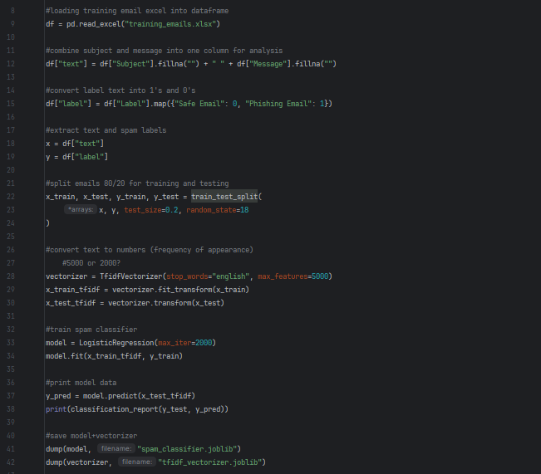
train_classifier.py

Slide 8
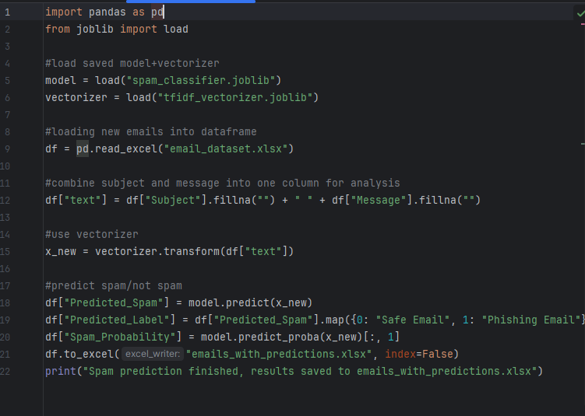
predict_spam.py

Slide 9
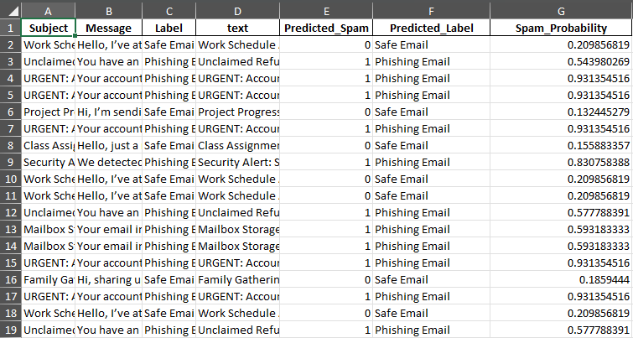
Sample of output excel file

Slide 10
Thank you!
Any questions?

